Slide 1
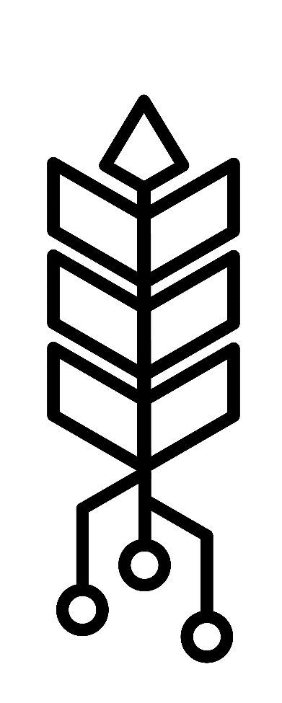
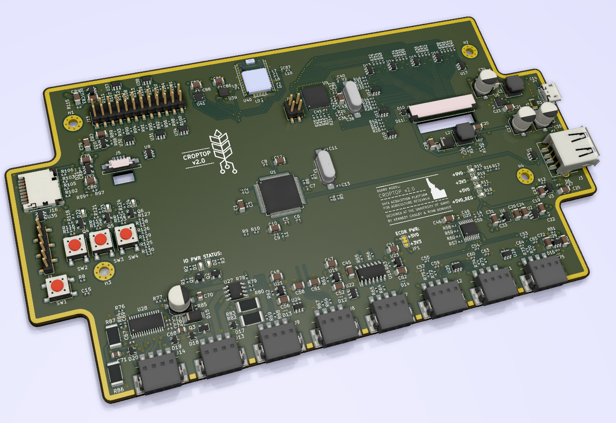
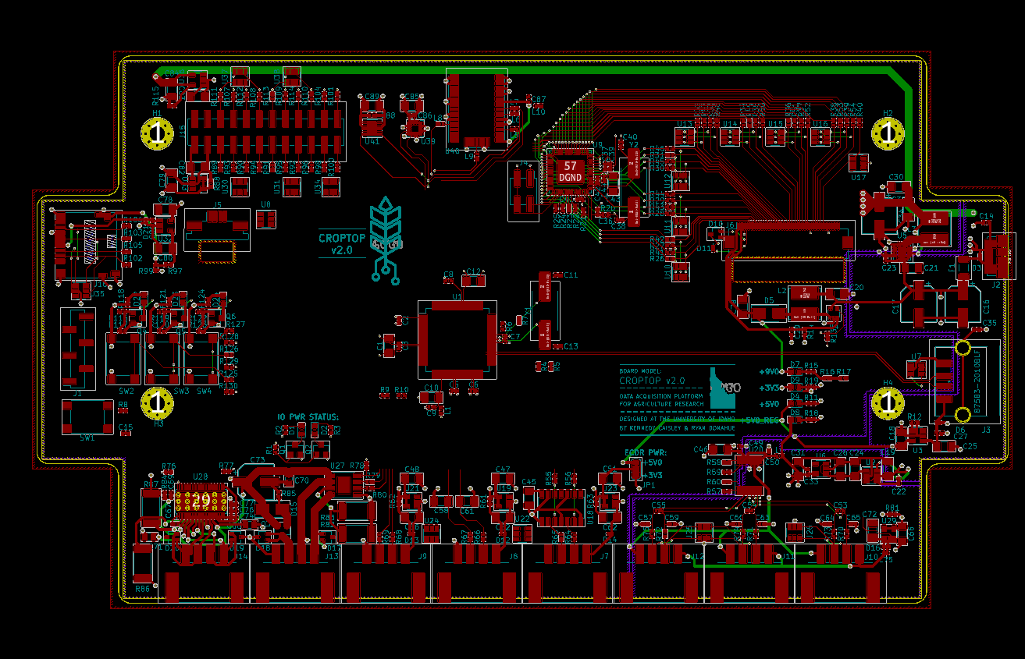
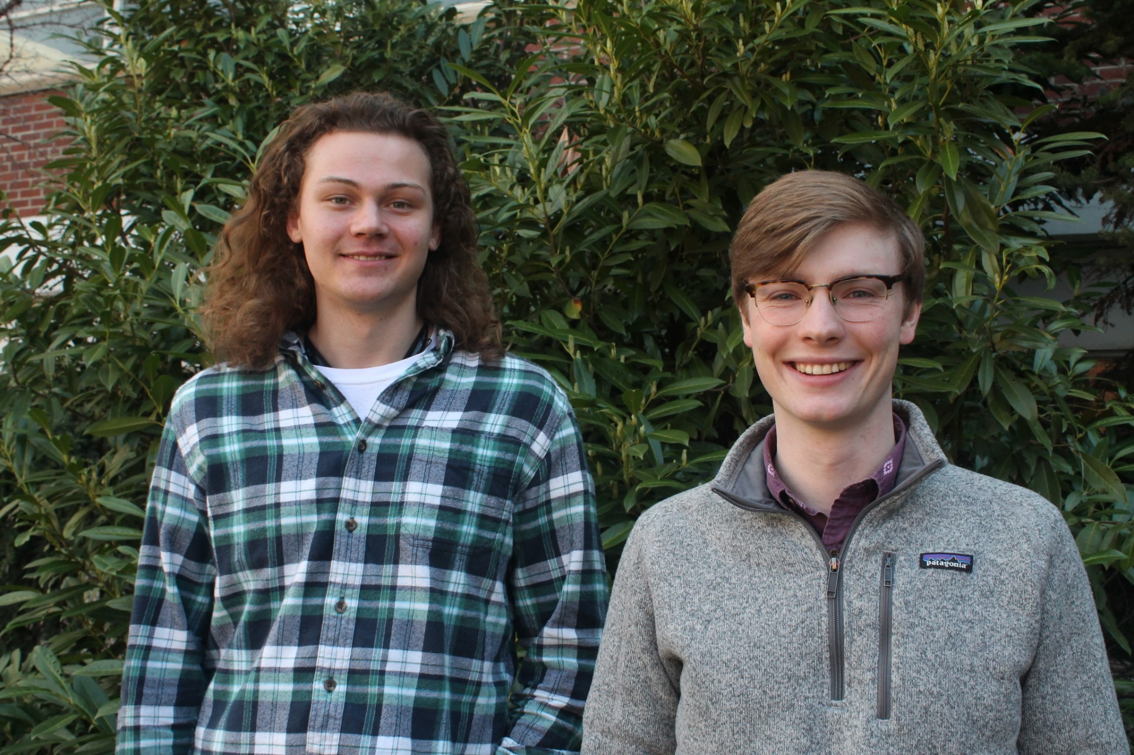
cereal grain Data Acquisition device Designed by Ryan Donahue & Kennedy Caisley
Project Background
Design Features
After more than a century of research, wind induced crop failure remains an unsolved problem resulting in tens of billions of dollars in economic losses each year. Research from the University of Idaho is patenting tools that will allow plant breeders to develop crop varieties highly resistant to stalk failure.
USB 2.0 Embedded Host for Bulk Data Transfer & Human Interface Devices
Three 24-bit ∆Σ ADC Channels for Fluke Load Cell Force Measurements
Graphic Processing Unit for 800x480 7” TFT LCD GUI Control and Resistive Touchscreen Feedback
160W DC Motor Driver for Linear Actuator Control
SD Card for Non-volatile Embedded Data Storage
Configurable 3.3V/5V Rotary Encoder Interface
ADC for Linear Actuator Positioning Potentiometer
GPS Receiver with Onboard Antenna for Time, Date, and Test Location
Ultrasonic Ranging Module Interface
Accelerometer for Tilt Measurement
Temperature and Humidity Sensor
Stepper Motor Controller
Design outcomes
Plans for a commercially viable data acquisition platform were designed then sent to a contract manufacturer for assembly. The new embedded hardware improves upon the prototype devices, currently being used by the client, in a number of ways:
Requirement | Prototype Devices | Current Design
Reduced Assembly Time | 20 hours of intern solder fun time | One-click orders through small-batch assembly
Reduced Cost | $600 per board | $150 per board
Better Data Acquisition | 15Hz with 16-bit ADC load cell data | 470Hz with 24-bit ADC load cell data
Improved User Input | Mechanical button input with delayed screen update rates | Resistive touch-screen with ms update rate
Quick Test Identification | Keyboard entry | Keyboard entry and barcode scanning
Increased Reliability | No ESD protection | IEC 61400-4 ESD protection
Easier Data Transfer | Obstructed SD card interface | USB bulk-transfer
Decreased Size | Two boards with 15 feet of cabling | One board ½ inch total height
Centralized Firmware Development | Raspberry Pi and Arduino based systems | PIC32 C based system with Github code repository
Expandable | Requires new PCB for additional circuitry | Robust options for daughter boards
Figure 1: Rendering of CropTop PCB
Team CropTop
Figure 2: CropTop PCB Layout Gerber
Left to Right: Ryan Donahue and Kennedy Caisley
Future Work
Acknowledgements
Create application software for existing devices using the newly developed hardware and device drivers found on the CropTop Github repository.
Client and Advisor: Dr. Daniel Robertson.
Additional thanks to Conrad Mearns for LCD firmware, Hailey Johnson for USB debugging help, and Ankit Gupta for his feedback on the project’s design.
Link: https://github.com/kcaisley/CropTop

